Slide 1
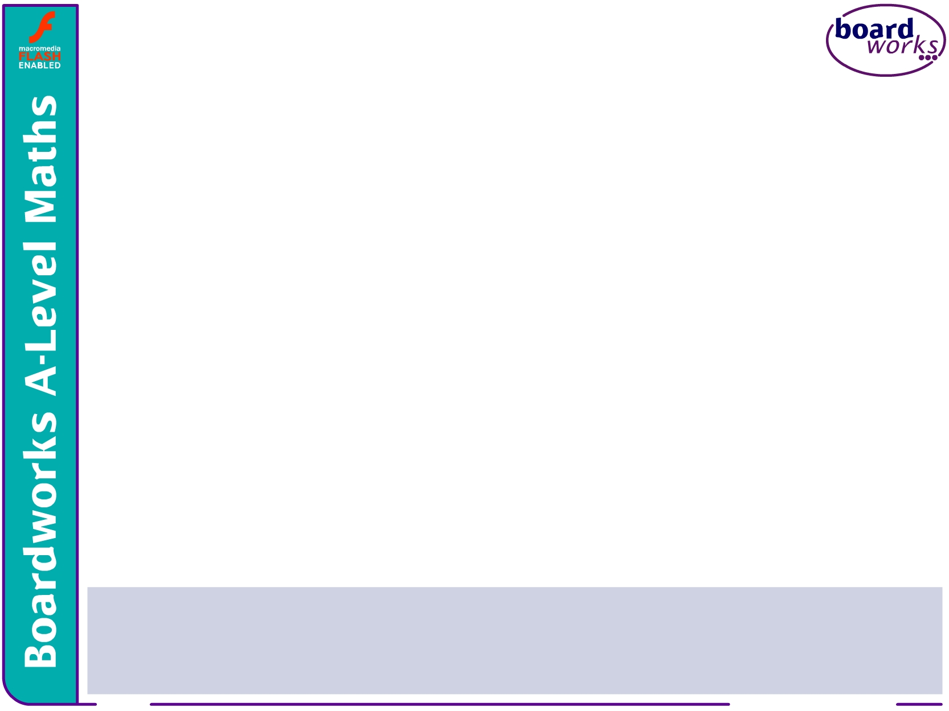
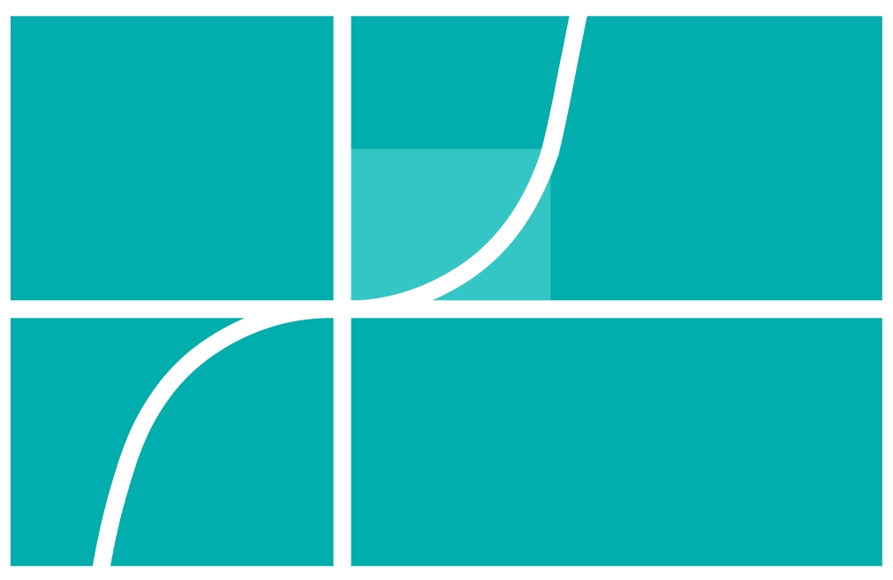



A-Level Maths:
Core 4 for Edexcel
C4.5 Integration 1
These icons indicate that teacher’s notes or useful web addresses are available in the Notes Page.
This icon indicates the slide contains activities created in Flash. These activities are not editable.
For more detailed instructions, see the Getting Started presentation.
<number> of 57
© Boardworks Ltd 2006

Slide 2



Integrals of standard functions
Integrals of standard functions
Reversing the chain rule
Integration by substitution
Integration by parts
Volumes of revolution
Examination-style question
Contents
<number> of 57
© Boardworks Ltd 2006

Slide 3
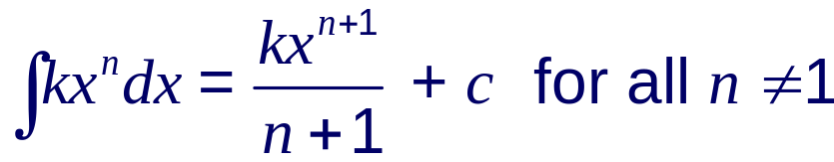
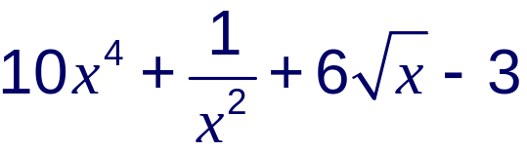
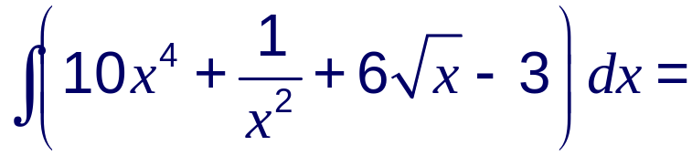
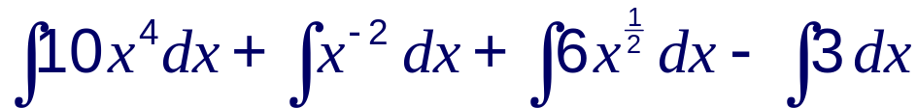
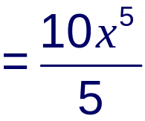
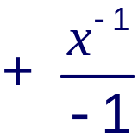
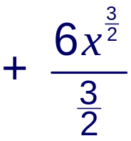


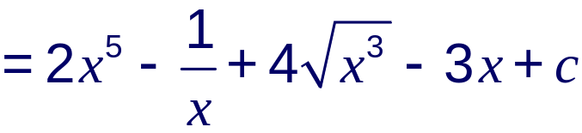
Review of integration
So far, we have only looked at functions that can be integrated using:
For example:
Integrate with respect to x.

Slide 4



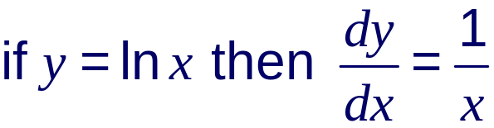
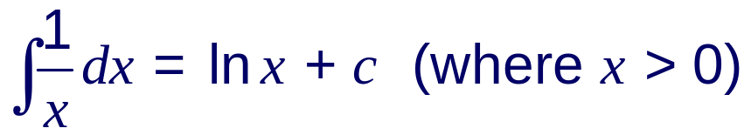
The integral of
The only function of the form x^{n} that cannot be integrated by this method is x^{–1} = .
Adding 1 to the power and then dividing would lead to the meaningless expression,
This does not mean that cannot be integrated.
Remember that
Therefore

Slide 5
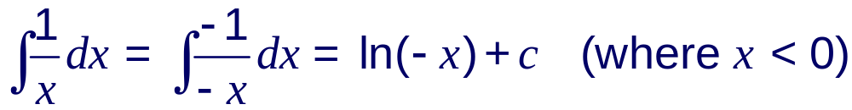
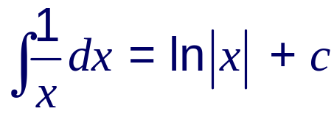
The integral of
We can only find the log of a positive number and so this is only true for x > 0.
However, does exist for x < 0 (but not x = 0). So how do we integrate it for all possible values of x?
We can get around this by taking x to be negative.
If x < 0 then –x > 0 so:
We can combine the integrals of for both x > 0 and x < 0 by using the modulus sign to give:
Notes:
Explain that the derivative of ln(–x) is ^{–1}/_{–x} = ¹/_{x}. This is possible as long as x is negative.
It is particularly important to remember the modulus sign when evaluating definite integrals involving ¹/_{x}. For indefinite integrals, however, the modulus sign is often left out and normal brackets are used instead.

Slide 6
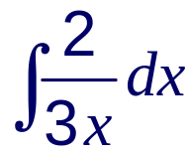
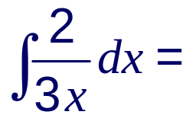
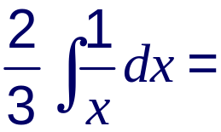
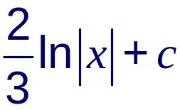
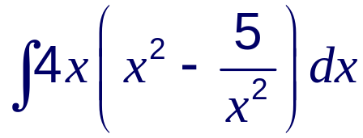
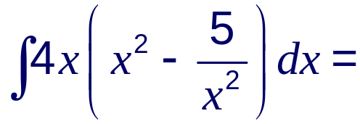
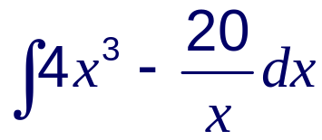

The integral of
Find
This is just the integral of multiplied by a constant.
Find
Notes:
Explain that constants can be taken outside of the integral sign if it helps, but it is not usually necessary to show this step except for emphasis.

Slide 7
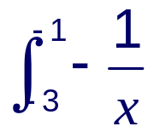
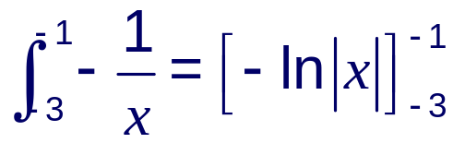
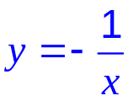



Definite integrals involving
It is particularly important to remember the modulus sign when evaluating definite integrals of functions involving .
Find the area under the curve y = – between x = –3,
x = –1 and the x-axis, writing your answer in the form ln a.
y
The area is given by .
–3
–1
0
x
Remember that ln 1 = 0
units squared

Slide 8

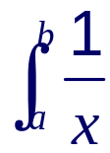
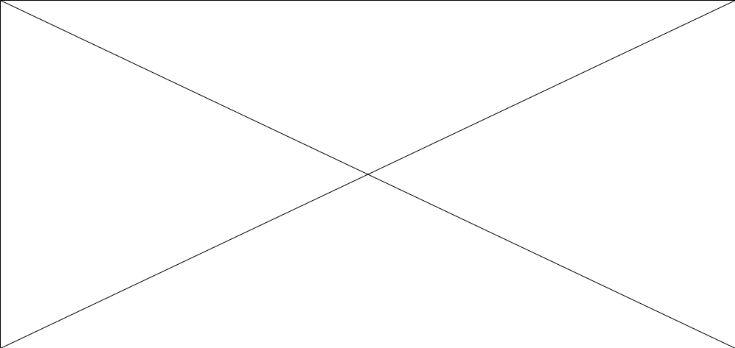
Definite integrals involving
We should note that definite integrals of the form can only
be evaluated if x = 0 does not lie in the interval [a, b].
Notes:
Stress that definite integrals of this form can only be integrated if the limits a and b are either both positive or both negative.

Slide 9
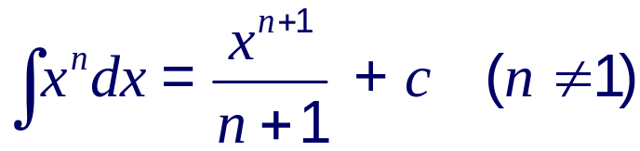
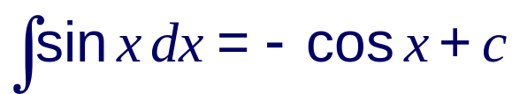
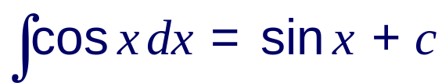
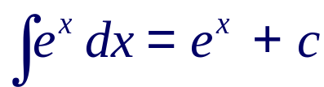

Integrals of standard functions
By reversing the process of differentiation we can derive the integrals of some standard functions.
These integrals should be memorized.
Notes:
The integral of ln x will be found when integration by parts is introduced.

Slide 10
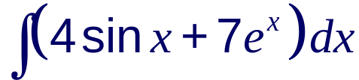
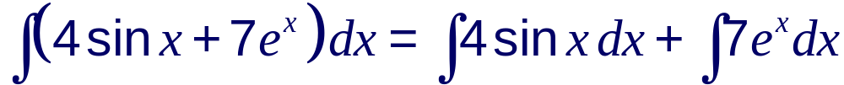
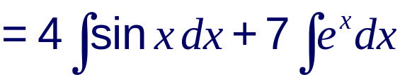


Integrals of standard functions
Also, if any function is multiplied by a constant k then its integral will also be multiplied by the constant k.
Find
In practice most of these steps can be left out.

Slide 11
Reversing the chain rule
Integrals of standard functions
Reversing the chain rule
Integration by substitution
Integration by parts
Volumes of revolution
Examination-style question
Contents
<number> of 57
© Boardworks Ltd 2006

Slide 12

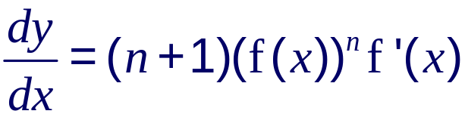
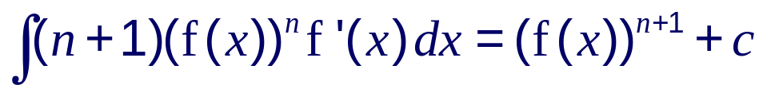
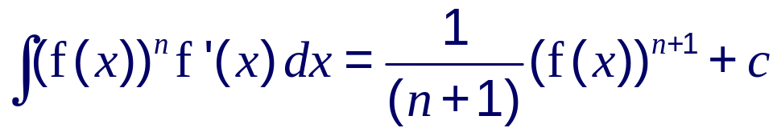
Reversing the chain rule
A very helpful technique is to recognize that a function that we are trying to integrate is of a form given by the differentiation of a composite function. This is sometimes called integration by recognition.
Let
By the chain rule:
So
It follows that for n ≠ 1
Notes:
You may wish to point out that if n = –1 we have a function of the form
^{f ’(x)}/_{f(x)}, the derivative of which is ln f(x). This form will be covered later in the presentation.

Slide 13
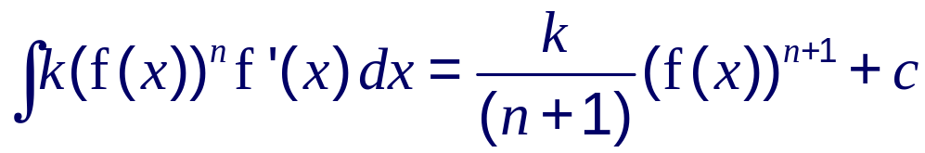
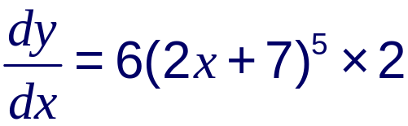
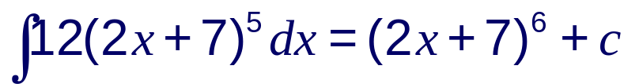
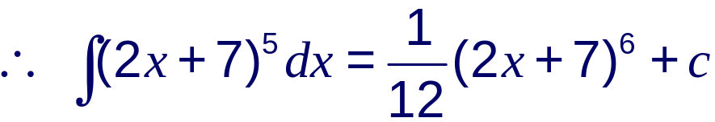
Reversing the chain rule
If the integral is multiplied by a constant k:
Don’t try to learn this formula, just try to recognize that the function you are integrating is of the form k(f(x))^{n} f ’(x) and compare it to the derivative of (f(x))^{n + 1}.
Suppose we want to integrate (2x + 7)⁵ with respect to x.
Consider the derivative of y = (2x + 7)⁶.
Using the chain rule:
= 12(2x + 7)⁵
So
Notes:
In the example of (2x + 7)⁵ point out that 2x + 7 is linear and so its derivative is a constant. This is dealt with by making a numerical adjustment at the end.
Note that the c in the last statement is 12 times smaller than the c in the previous statement. The same letter has been used for convenience. If required, however, a different letter can be used to represent the constant such as C.

Slide 14
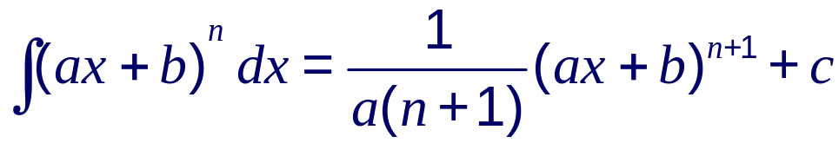
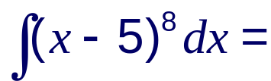
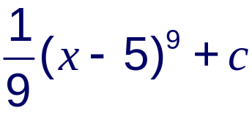
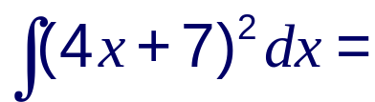
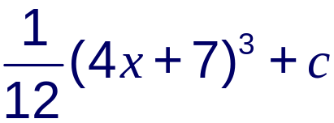
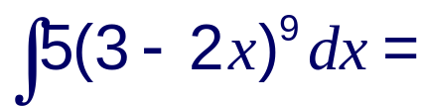
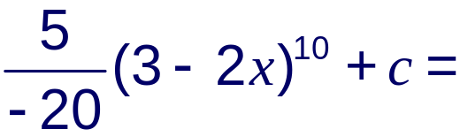
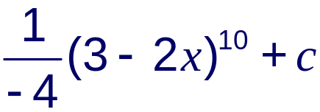
Reversing the chain rule
In general, you can integrate any linear function raised to a power using the formula:
With practice, integrals of this type can be written down directly. For example:
Notes:
Again, for convenience, the same letter has been used to represent the constants in the last two statements.

Slide 15
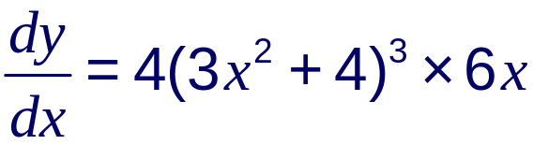
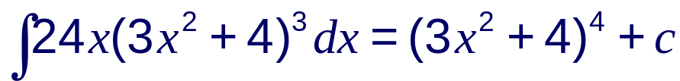

Reversing the chain rule
Let’s look at some more integrals of functions of the form k(f(x))^{n} f ’(x).
Integrate y = x(3x² + 4)³ with respect to x.
Notice that the derivative of 3x² + 4 is 6x.
Now consider the derivative of y = (3x² + 4)⁴.
Using the chain rule:
= 24x(3x² + 4)³
So

Slide 16





Reversing the chain rule
Find .
Notice that the derivative of 2x³ – 9 is 6x².
Now consider the derivative of y = (2x³ – 9)³.
Using the chain rule:
= 18x²(2x³ – 9)²
So

Slide 17











Reversing the chain rule
Find .
x² is the derivative of (x³ – 1).
Start by writing as
plus 1 is
Now consider the derivative of y =
Using the chain rule:
So

Slide 18







Reversing the chain rule for exponential functions
When we applied the chain rule to functions of the form e^{f(x)} we obtained the following generalization:
We can reverse this to integrate functions of the form k f ’(x)e^{f(x)}. For example:
A numerical adjustment is usually necessary.

Slide 19






Reversing the chain rule for exponential functions
In general,
Find .

Slide 20




Reversing the chain rule for exponential functions
With practice, this method can be extended to cases where the exponent is not linear. For example:
Find .
Notice that the derivative of 2x² is 4x and so the function we are integrating is of the form k f ’(x)e^{f(x)}.
Notes:
Explain that removing a factor of ¼ allows us to write the integrand in the form f ’(x) e^{f(x)}. This is a useful step to remember when integrating functions by recognition.

Slide 21








Reversing the chain rule for logarithmic functions
When we applied the chain rule to functions of the form ln f(x) we obtained the following generalization:
We can reverse this to integrate functions of the form
For example:
Remove a factor of to write the function in the form .
In general,
Notes:
The modulus sign has been used for the reasons discussed earlier.

Slide 22






Reversing the chain rule for logarithmic functions
Find .
This is now of the form .
Evaluate , writing your answer in the form a ln b.
First of all, note that the graph of y = has a discontinuity
when 2x – 7 = 0, that is when x = 3.5.
This is outside the interval [–1, 2] and so the integral is valid.
Notes:
When finding the definite integral of a discontinuous function it is worth checking that the discontinuity lies outside the required interval. This can be done by sketching a graph of the integrand in question.

Slide 23







Reversing the chain rule for logarithmic functions
This is now of the form .
This can be written in the required form by using the rule that
ln a – ln b = ln .
Notes:
This could also be written in the form ln ¹/₉.

Slide 24








Reversing the chain rule for logarithmic functions
Find .
This is now of the form .
Find .
This is now of the form .

Slide 25








The integral of tan x
We can find the integral of tan x by writing it as and
recognizing that this fraction is of the form .
It is ‘tidier’ to rewrite this without a minus sign at the front, using the fact that –ln a = ln a^{–1}:
Notes:
The same method can be used to find the integral of cot x.

Slide 26






Reversing the chain rule for trigonometric functions
When we applied the chain rule to functions of the form sin f(x) and cos f(x) we obtained the following generalizations:
We can reverse these to integrate functions of the form
f ’(x) cos f(x) and f ’(x) sin f(x). For example:

Slide 27





Reversing the chain rule for trigonometric functions
As with other examples a numerical adjustment is often necessary.
This is now of the form –f ’(x) sin f(x).
In general, when dealing with the cos and sin of linear functions:

Slide 28
Integration by substitution
Integrals of standard functions
Reversing the chain rule
Integration by substitution
Integration by parts
Volumes of revolution
Examination-style question
Contents
<number> of 57
© Boardworks Ltd 2006

Slide 29




Integration by substitution
With practice, the technique of integration by recognition can save a lot of time.
However, when it is too difficult to use integration by recognition we can use a more formal method of reversing the chain rule called integration by substitution.
To see how this method works consider the integral
Let u = 5x + 2 so that
The problem now is that we can’t integrate a function in u with respect to x. We therefore need to write dx in terms of du.

Slide 30








Integration by substitution
When we used the chain rule for differentiation we saw that we can treat informally as a fraction, so:
So if u = 5x + 2 and dx :
Now change the variable back to x:
Notes:
Stress that we must change the variable back to x at the end.
We can check that the final solution is correct by differentiating it using the chain rule.

Slide 31








Reversing the chain rule for logarithmic functions
Use a suitable substitution to find .
Let u = 2x² – 5
Substituting u and dx into the original problem gives:
Notice that the x’s cancel out.

Slide 32





Integration by substitution
Now we need to change the variable back to x :
This integral could also have been found directly by recognition.
However, there are functions that can be integrated by use of a suitable substitution but not by recognition. For instance:
Use the substitution u = 1 – 2x to find .
If u = 1 – 2x then

Slide 33





Integration by substitution
Also if u = 1 – 2x then
We also have to substitute the x so that the whole integrand is in terms of u.
Substituting these into the original problem gives:

Slide 34







Integration by substitution
Changing the variable back to x gives:
Notes:
The final step brings the minus sign into one of the brackets to give a slightly ‘tidier’ form.

Slide 35








Definite integration by substitution
When a definite integral is found by substitution it is easiest to rewrite the limits of integration in terms of the substituted variable.
Use the substitution u = to find the area under the curve
y = between x = 4 and x = 7.
Using the chain rule for differentiation.
If u = then

Slide 36







Definite integration by substitution
Now we need to find x in terms of u.
If u = then
u² = 8 – x
x = 8 – u²
Rewrite the limits in terms of u:
when x = 3,
when x = 1,
The area is given by . Rewrite this in terms of u:

Slide 37





Definite integration by substitution
Therefore, the required area is units squared.
Notes:
The final calculation can be done using a calculator if required.

Slide 38
Integration by parts
Integrals of standard functions
Reversing the chain rule
Integration by substitution
Integration by parts
Volumes of revolution
Examination-style question
Contents
<number> of 57
© Boardworks Ltd 2006

Slide 39


Integration by parts
Suppose we wish to integrate the product of two functions, such as x sin x, where one of the functions is not related to the derivative of the other.
An expression such as this can be integrated using the method of integration by parts.
When we differentiate the product of two functions u and v we use the product rule:
where u and v are functions of x.
Integrating throughout with respect to x gives:
Notes:
Stress that integrating ^{d}/_{dx}(uv) with respect to x gives uv.

Slide 40





Integration by parts
This can be rearranged to give:
To integrate a product using this formula we let one part equal
u and the other equal .
We find by differentiating the part we called u.
We find v by integrating the part we called .
It is important to choose u and so that
is easier to integrate than .

Slide 41







Integration by parts
So, to integrate x sin x with respect to x:
Let and
differentiate
integrate
So
and
We don’t need the “+ c” here.
Now, using the formula :

Slide 42






Integration by parts
Find .
Let and
So and
Now, apply the formula :

Slide 43









Integration by parts
Find .
We don’t know the integral of ln x so:
let and
so and
Now, using the formula, :
Notes:
In general if one of the functions in the product is a power of x then we let that function equal u so that it is simplified when differentiated. Products where one of the functions is of the form ln x are an exception to this general rule as shown here.

Slide 44







The integral of ln x
We can also use integration by parts to find the integral of ln x.
We do this by writing ln x as (1 × ln x).
Let and
So
and
Now we can integrate by parts:
Notes:
This result does not need to be learnt, but students should be familiar with its derivation.

Slide 45










Integration by parts
To evaluate a definite integral using integration by parts we use:
Evaluate .
Let and
So
and
sin ^{π}/₂ = 1
cos ^{π}/₂ = 0
cos 0 = 1

Slide 46
Volumes of revolution
Integrals of standard functions
Reversing the chain rule
Integration by substitution
Integration by parts
Volumes of revolution
Examination-style question
Contents
<number> of 57
© Boardworks Ltd 2006

Slide 47

Volumes of revolution
Consider the area bounded by the curve y = f(x), the x-axis and x = a and x = b.
If this area is rotated 360° about the x-axis a three-dimensional shape called a solid of revolution is formed.
The volume of this solid is called its volume of revolution.

Slide 48

Volumes of revolution
We can calculate the volume of revolution by dividing the volume of revolution into thin slices of width δx.
The volume of each slice is approximately cylindrical, of radius y and height δx, and is therefore approximately equal to
πy²δx

Slide 49



Volumes of revolution
The total volume of the solid is given by the sum of the volume of the slices.
The smaller δx is, the closer this approximate area is to the actual area.
We can find the actual area by considering the limit of this sum as δx tends to 0.
This limit is represented by the following integral:

Slide 50

Volumes of revolution
So in general, the volume of revolution V of the solid generated by rotating the curve y = f(x) between x = a and x = b about the x-axis is:
Similarly, the volume of revolution V of the solid generated by rotating the curve x = f(y) between y = a and y = b about the y-axis is:
Volumes of revolution are usually given as multiples of π.
Notes:
Note that the constant multiplier π can be taken outside of the integral sign if required.

Slide 51







Volumes of revolution
Find the volume of the solid formed by rotating the area between the curve y = x(2 – x), the x-axis, x = 0, and x = 2 360° about the x-axis.

Slide 52








Volumes of revolution
Find the volume of the solid formed by rotating the area between the curve y = , the y-axis, y = 1, and y = 2 360° about the y-axis.
Rearranging
y = gives x = .

Slide 53
Examination-style question
Integrals of standard functions
Reversing the chain rule
Integration by substitution
Integration by parts
Volumes of revolution
Examination-style question
Contents
<number> of 57
© Boardworks Ltd 2006

Slide 54



Examination-style question
Show that cos²x = (1 + cos 2x)
b) The diagram below shows the finite region R which is bounded by the curve y the x-axis, the y-axis and the line x = .
Using the substitution x = sin u, or otherwise, find the area of the region R to 3 significant figures.
c) Find the volume of the solid formed when R is rotated through 360° about the x-axis to 3 significant figures.
y
R
0
x
Notes:
If this form of the double angle identity for cos 2A cannot be recalled then more steps may be necessary.

Slide 55




Examination-style question
a) RHS = (1 + cos 2x)
Using the double angle identity cos 2A ≡ 2cos²A – 1.
= (1 + (2cos²x – 1))
= (2cos²x)
= cos²x = LHS
b) The area of R is given by
Using the substitution x = sin u we have:
Find u when x is 0 and ½:
when x = 0, u = 0
and when x = , u =
Notes:
If this form of the double angle identity for cos 2A cannot be recalled then more steps may be necessary.
The alternative to finding the area of R by integration is to treat the region as the sum of a sector with a radius of 1 and angle ^{π}/₆, and a triangle of base length ¹/₂ and height ^{√3}/₂. This gives the area of the sector as ^{π}/₁₂ and the area of the triangle ^{√3}/₈ – the same area as we obtain by integration.

Slide 56







Examination-style question
Now make the substitution:
Using the identity
cos²A = 1 – sin²A.
Using the identity
cos²A = (1 + cos 2A).
Therefore, the area of region R is 0.478 units squared (to 3 s.f.).

Slide 57





Examination-style question
c) The required volume of revolution is given by
Therefore, the volume formed when R is rotated about the
x-axis is 1.44 units cubed (to 3 s.f.).
Notes:
Note that the constant multiplier π can be taken outside of the integral sign if required.

